Slide 1

Employee Attrition
By- Omkar Madkholkar
Under guidance – Prof. Ankita Pai

Slide 2
Problem Statement
The key to success in any organization is attracting and retaining top talent.
Task of HR to determine which factors keep employees at company and which prompt others to leave.
And to know what factors can change to prevent the loss of good people.

Slide 3
About Data.
Data set from Kaggel.com.
https://www.kaggle.com/datasets/patelprashant/employee-attrition
Data Size (1471 * 35 )

Slide 4
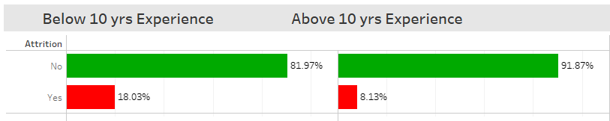
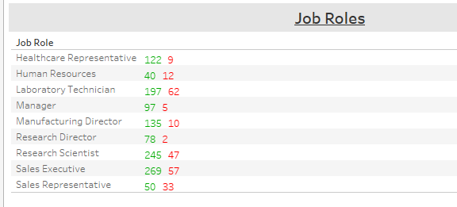

Slide 5
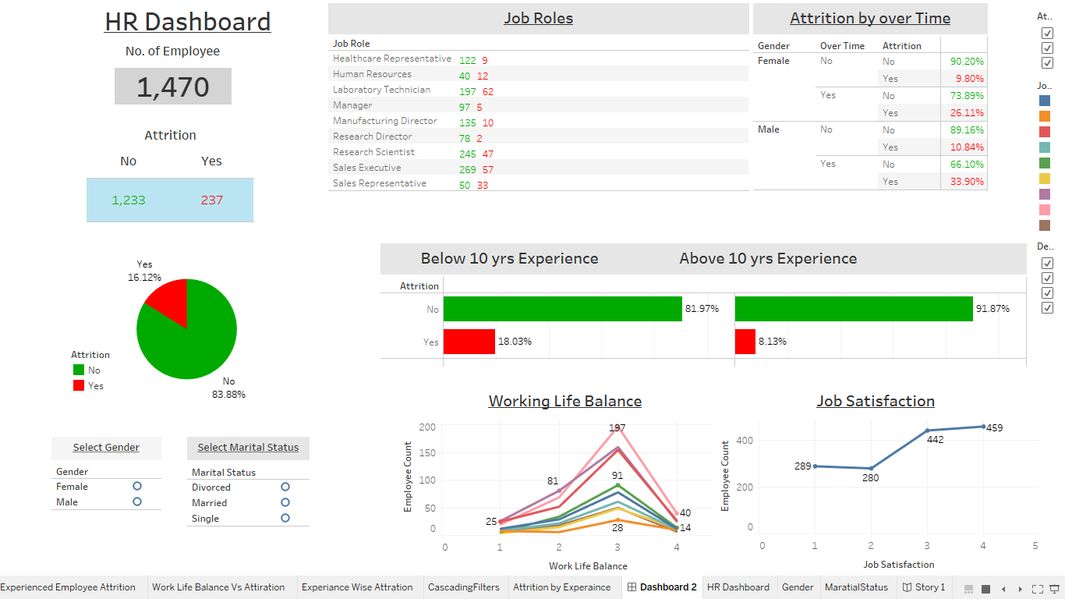

Slide 6
Thank you.

